Slide 1
Chatbot For FAQs
Presented By : M. Pooja
Department : B. Tech (Artificial Intelligence & Data Science)
College : G.K.M College Of Engineering and Technology

Slide 2
Agenda
Introduction
Problem Statement
Objectives
System Architecture
Tools & Technologies
Implementation Workflow
Sample Dataset
Code Snippet
Output Example
Sample Chat UI
Challenges
Future Scope
Conclusion

Slide 3
Introduction
In the digital era, users expect quick and accurate answers to their questions.
Static FAQ pages are time-consuming and often inefficient.
A chatbot for FAQs uses AI and NLP to respond to user queries in a conversational manner.
It understands the user's intent and fetches the most relevant answer from a pre-defined FAQ set.
This enhances user experience, ensures 24/7 availability, and reduces manual support efforts.

Slide 4
Problem Statement
Users often struggle to find accurate answers on lengthy or static FAQ pages.
i. Traditional FAQ systems lack interactivity, personalization, and real-time response. ii. Repetitive queries consume valuable time and resources of human support teams. iii. There is a need for an intelligent, automated system that can: 1. Understand user questions in natural language 2. Match them with relevant FAQs 3. Respond instantly and accurately
Goal:
Develop an AI-powered chatbot that efficiently answers user queries using an FAQ database and Natural Language Processing (NLP).

Slide 5
Objectives
Develop an intelligent chatbot that interacts with users in natural language.
Integrate a database of Frequently Asked Questions (FAQs) with their respective answers.
Implement NLP techniques to understand and process user queries effectively.
Match user input with the most relevant FAQ using similarity or intent detection.
Provide instant and accurate responses to reduce support workload.
Ensure scalability and ease of use for deployment across websites or apps.
Enhance user satisfaction through 24/7 automated support

Slide 6
System Architecture
User
Chatbot UI/Frontend (web)
NLP Processor
(Tokenization, Lemmatizaion, etc.)
Similarity Matching
(eg. Cosine Sim.)
FAQ Database (Questions & Answers)
Response Generator
Output

Slide 7
Tools & Technologies
Language: Python
NLP Libraries: NLTK, SpaCy, Scikit-learn
Framework: Flask / Streamlit
Database: SQLite / JSON
Interface: HTML, CSS (for web UI)
Dev Tools: VS Code, GitHub

Slide 8
Implementation Workflow
Collect FAQs Prepare a dataset of question–answer pairs.
Preprocess Text Clean data using NLP: tokenization, stopword removal, lemmatization.
Vectorization Convert questions into numerical vectors using TF-IDF.
Similarity Matching Use Cosine Similarity to compare user query with FAQ questions.
Best Match Selection Return the answer with the highest similarity score.
Build Chat Interface Create a simple UI using Flask / Streamlit to interact with users.

Slide 9
Sample Dataset
ID | Question | Answer
1 | What is your return policy? | You can return any item within 30 days of purchase.
2 | How do I reset my password? | Click on 'Forgot Password' on the login page to reset it.
3 | What are your customer support hours? | Our support team is available 24/7.
4 | How can I track my order? | Use the tracking ID sent to your email on our tracking page.
5 | Do you offer international shipping? | Yes, we ship to over 50 countries worldwide.

Slide 10
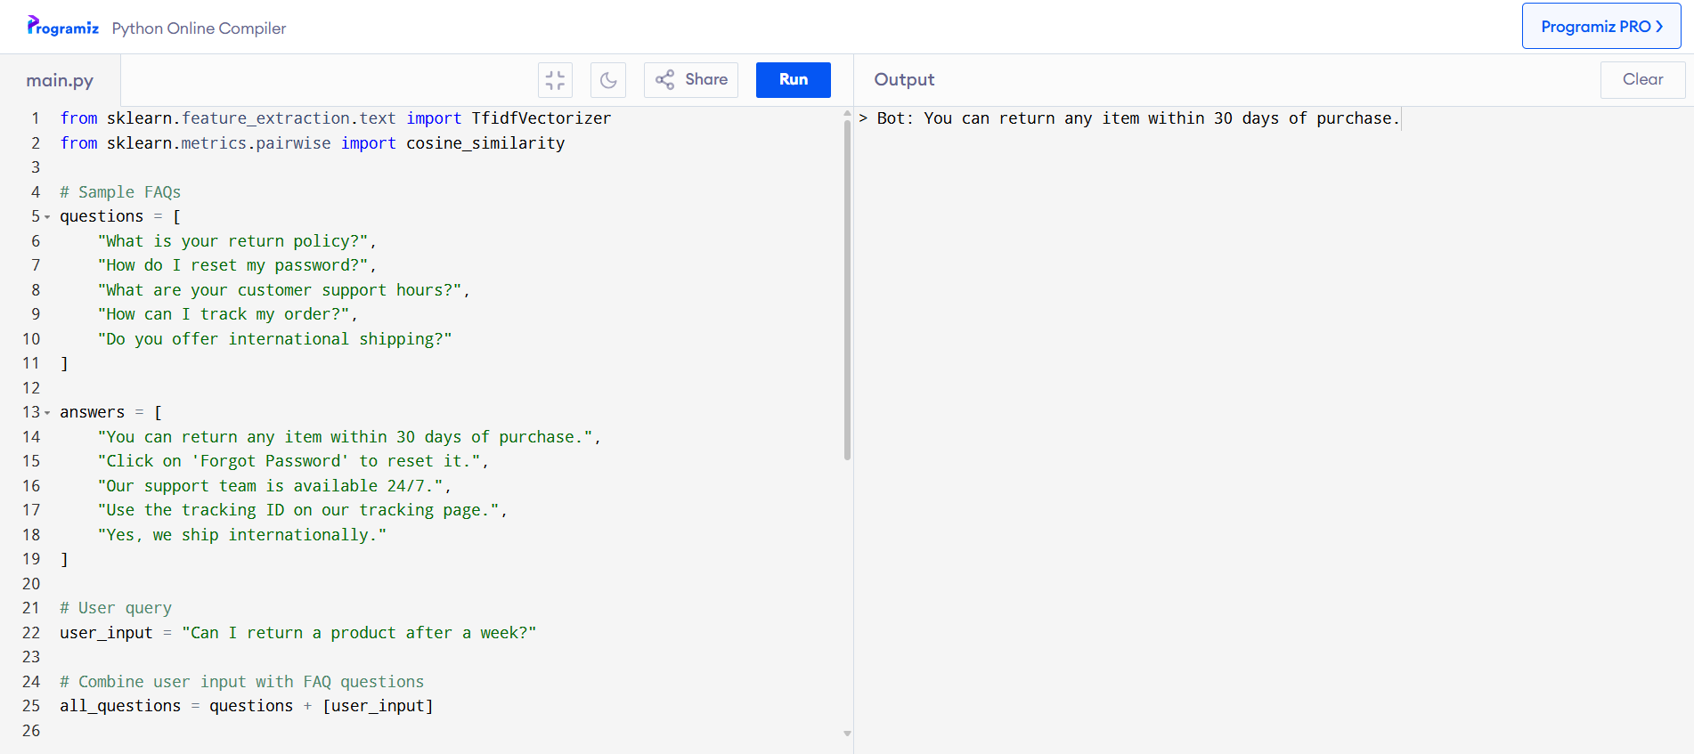
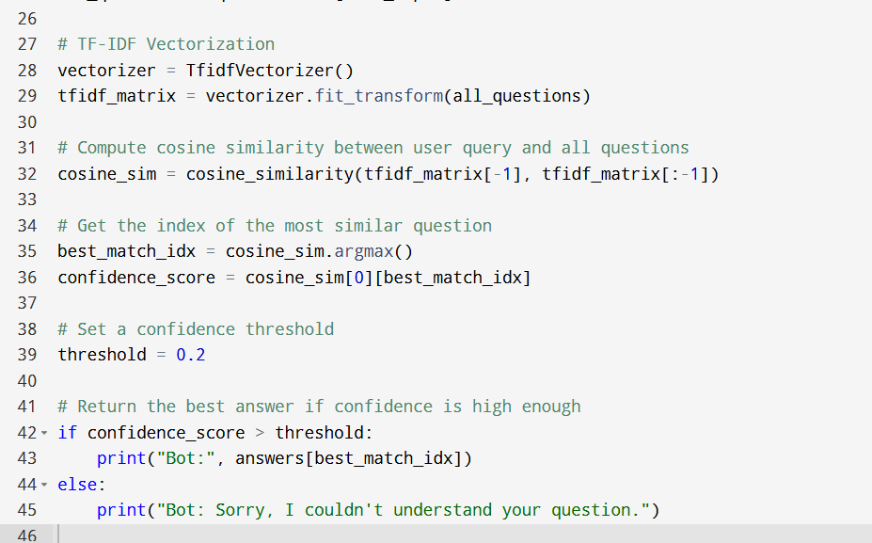
Code Snippet

Slide 11
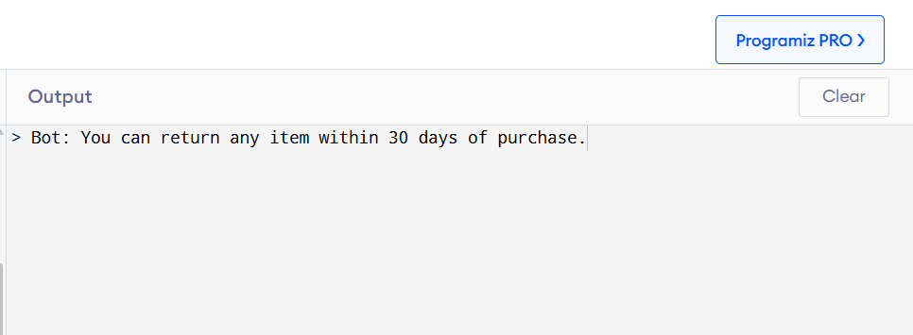
Output Example

Slide 12
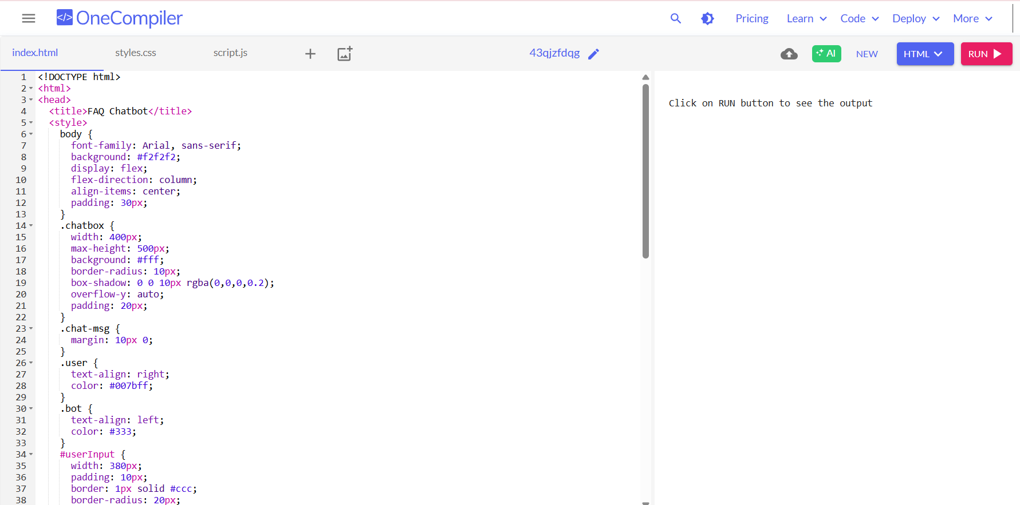
Sample Chat UI

Slide 13
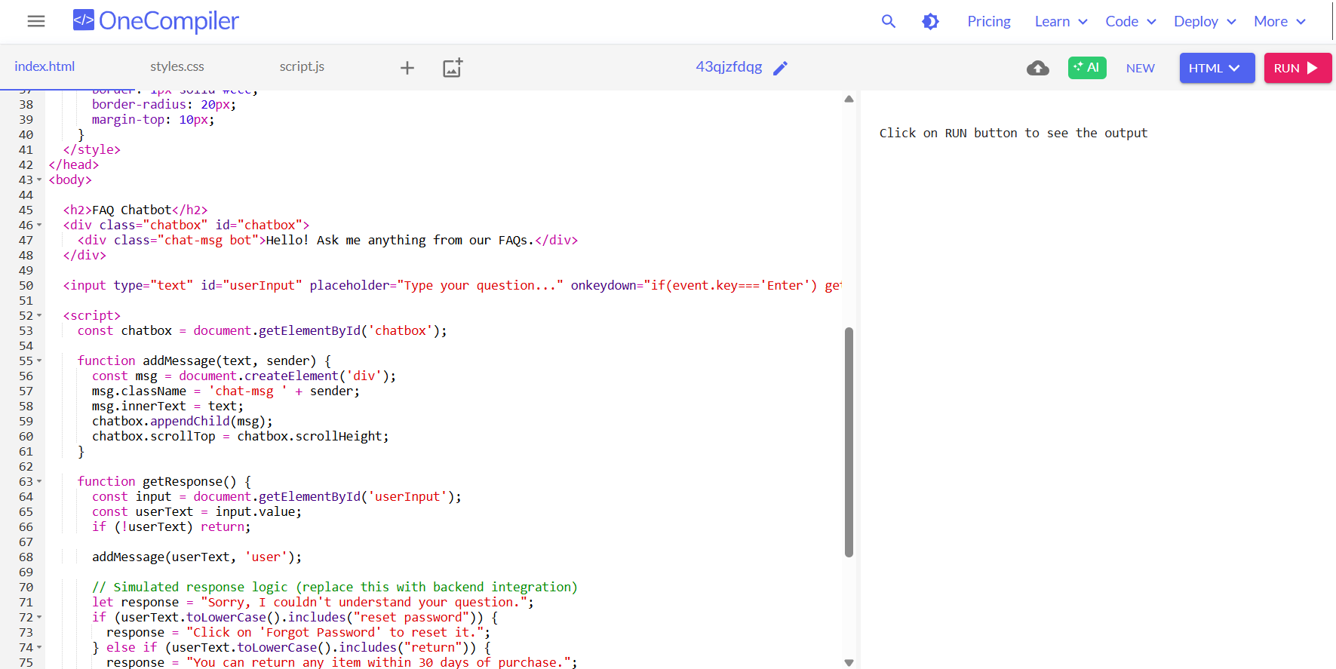

Slide 14
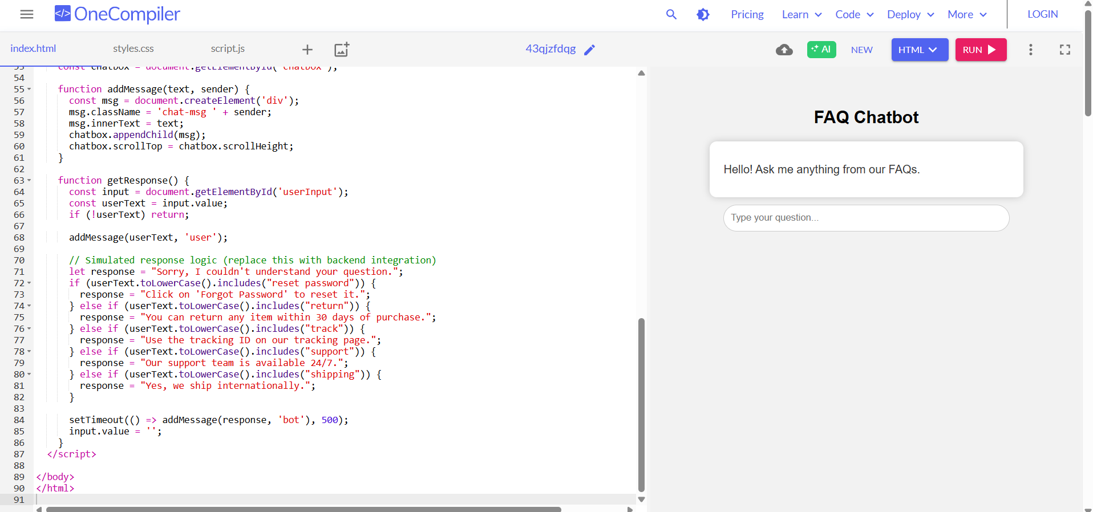

Slide 15
Challenges & Future Scope
Challenges:
Future Scope:
Understanding varied user queries
Matching synonyms and indirect questions
Handling vague or incomplete inputs
Choosing the right similarity threshold
Limited scalability with large FAQ sets
No self-learning or adaptation
Integrate BERT / GPT models for better semantic understanding
Voice-based interaction using Speech-to-Text APIs.
Multilingual support to handle diverse user bases.
Self-learning from user feedback to improve accuracy.
Admin dashboard for live FAQ updates and analytics
Deploy on platforms like WhatsApp, Telegram, or mobile apps

Slide 16
Conclusion
The FAQ Chatbot offers a smart and interactive way to handle repetitive user queries.
By using NLP and similarity matching, it provides quick and relevant responses.
It enhances user experience, reduces manual support load, and operates 24/7.
With future enhancements like semantic models and multi-language support, the chatbot can become even more powerful and scalable.

